Slide 1
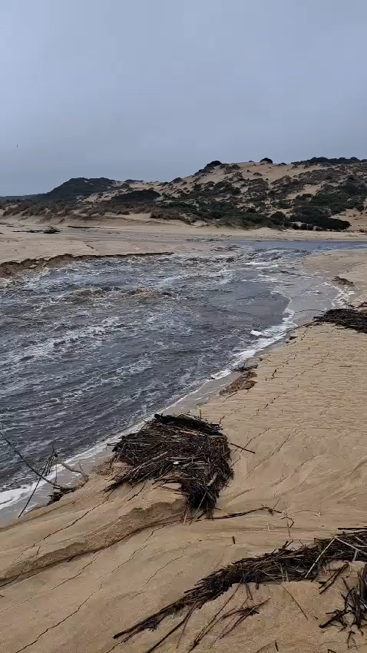
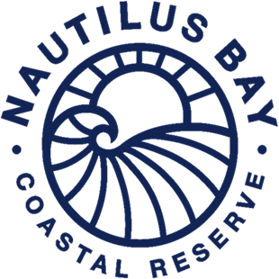
Click to Play
July 2024
Reserve Manager’s Monthly Report
“The ocean stirs the heart, inspires the imagination and brings eternal joy to the soul”
Inside this report
Building projects.
Water.
Estate Projects.
Environment.
MAINTENANCE PERFORMED.
SECURITY.
GENERAL.

Slide 2
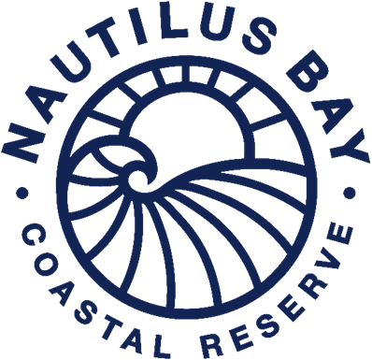
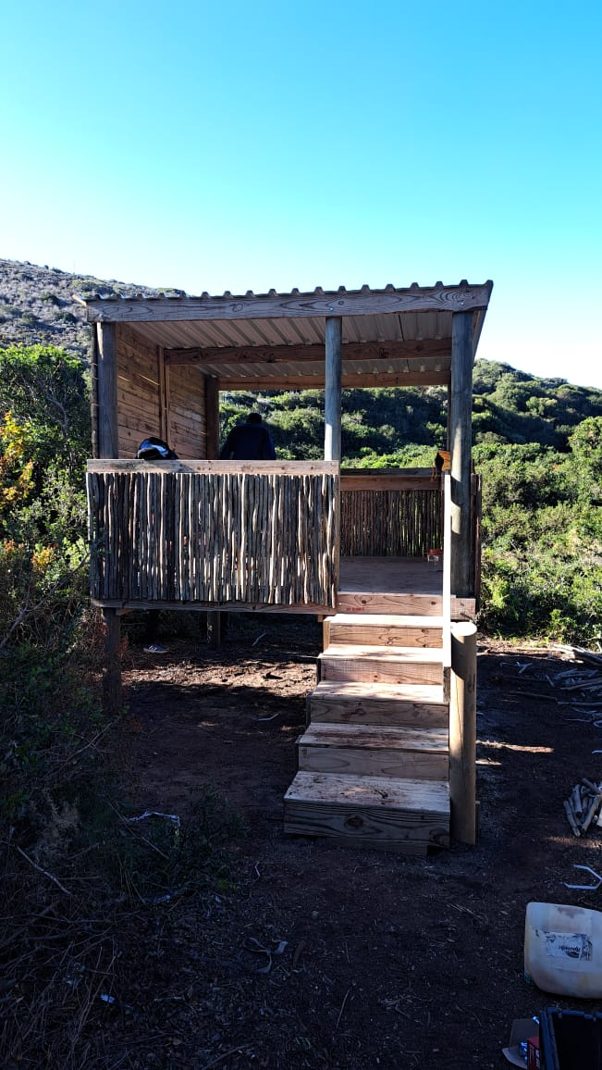
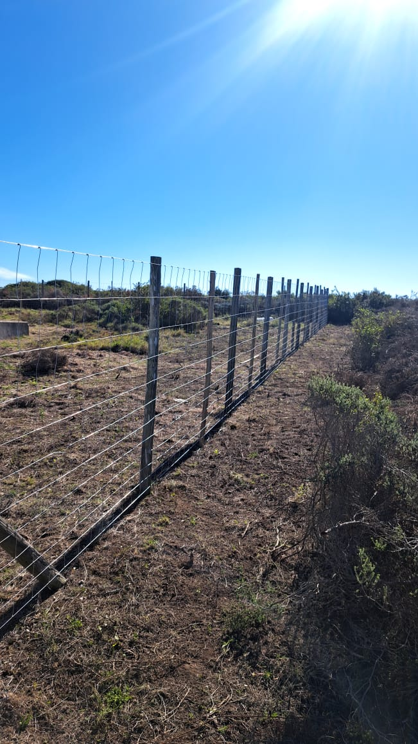
1. Building Projects
Unit 32 is currently painting, "almost there”
Construction activities at Unit 34 are progressing slowly.
Units 16,17, and 48 has started with foundations.
Be on the lookout for trucks moving around the reserve.
2. Water
Water usage for the month of July was measured on 25 July 2024.
The bulk water reading was 20180 kl for the month of July. This is 641 kl for the month.
3. Estate Projects
Wastewater Plant Fence Renewal: The perimeter fence was replaced due to severe rusting, ensuring a secure boundary.
Fence Repairs: Ongoing repairs to damaged fences are in progress.
Fire Department Inspection: A successful inspection was conducted, with suggestions to explore controlled burning in specific areas, which we are currently considering.
Wildlife Habitat Enhancement: A new bird-friendly habitat has been established, and we invite you to enjoy it.
Grounds Maintenance:
Grass cutting and maintenance were performed.
Weed control measures were applied to problematic areas.
Damaged streetlights were repaired or replaced with new ones.
2

Slide 3
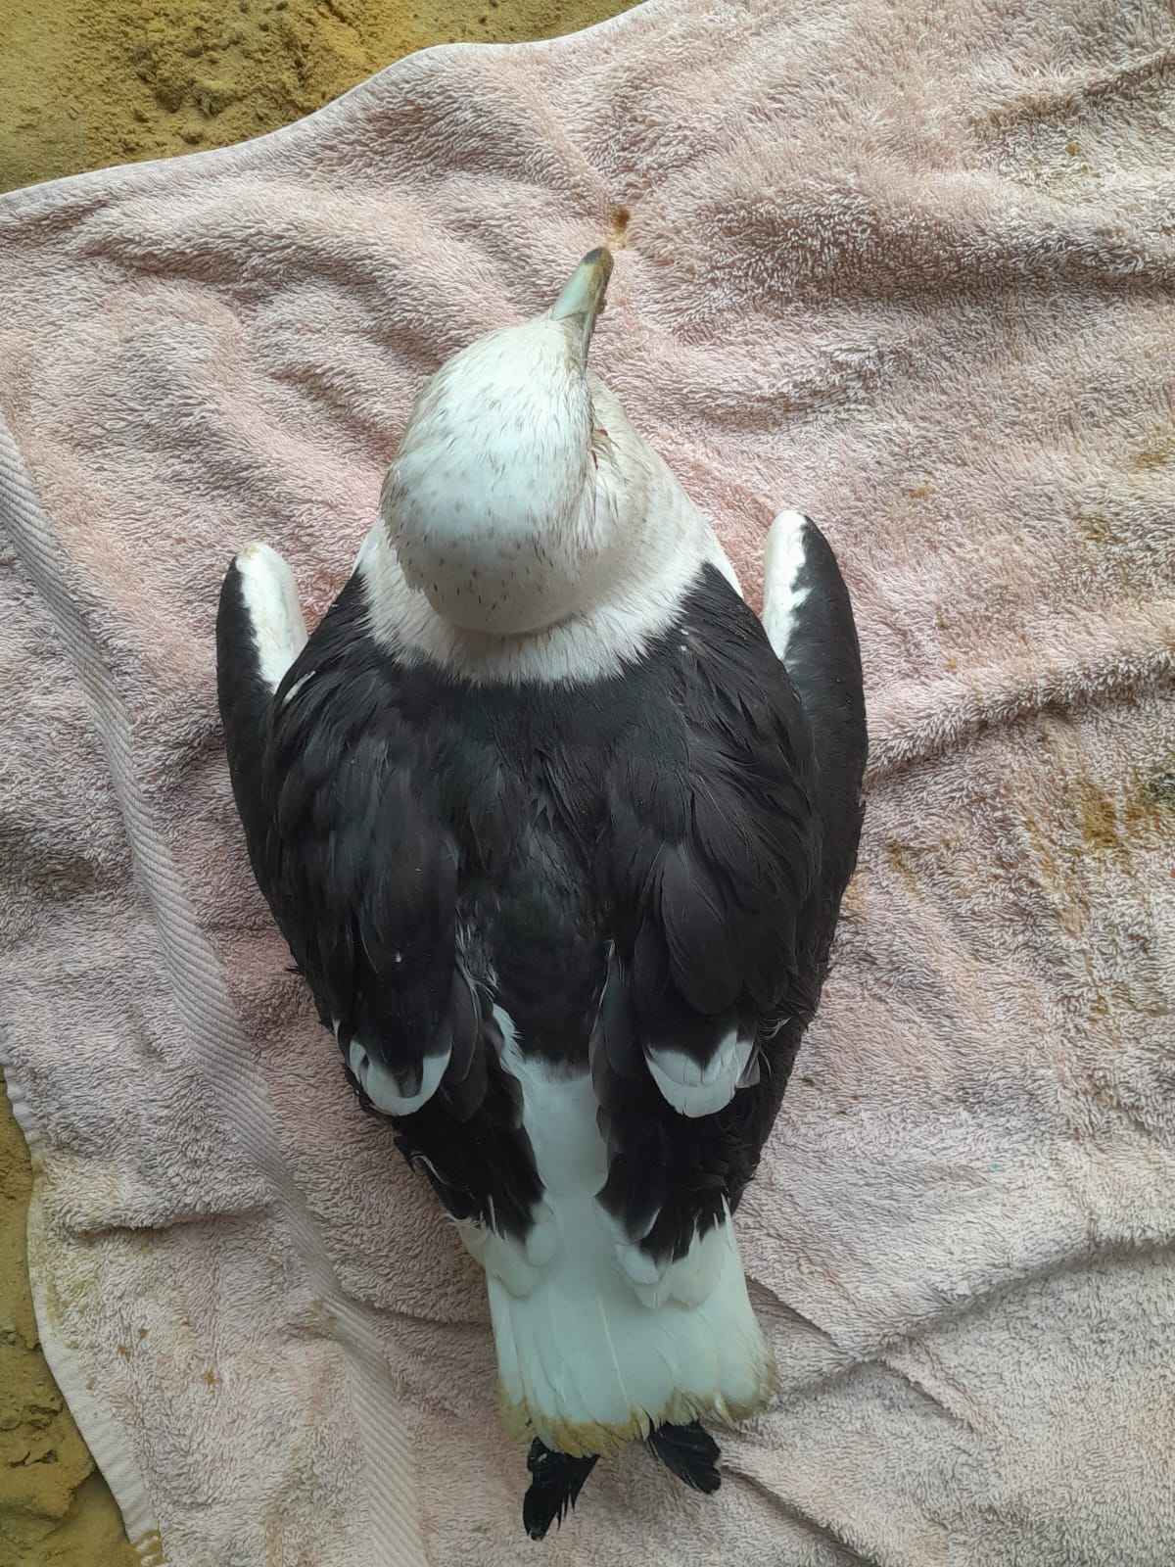
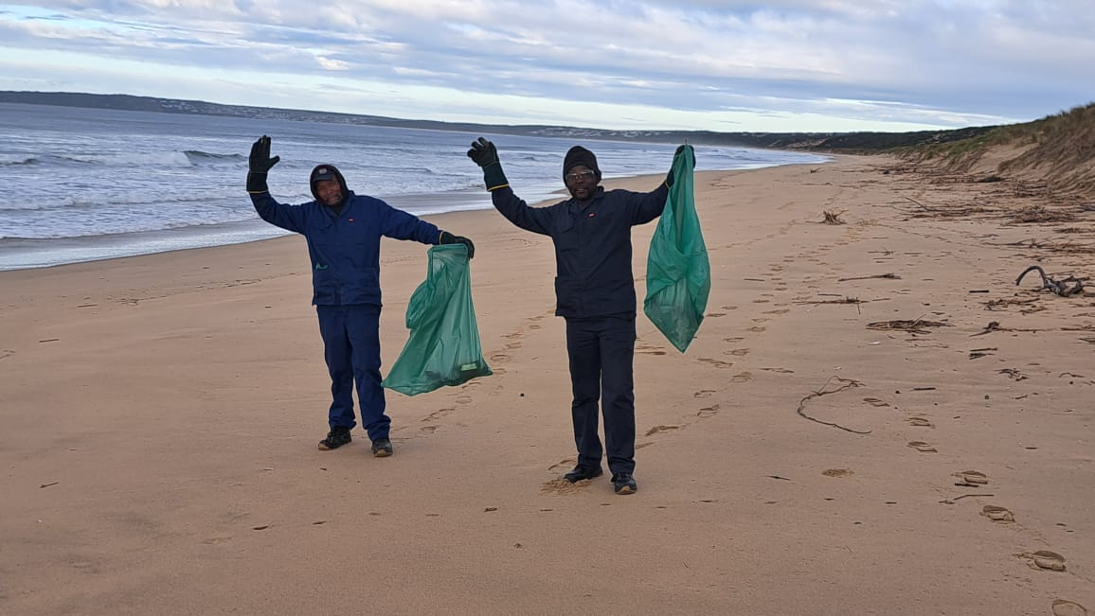
4. Environment
Due to heavy rainfall, the middle road to the beach on the reserve is currently closed. Residents are advised to use the western roads as an alternative, which will help maintain their usability.
We appreciate the efforts and working hard to keep our beaches clean. Their dedication is making a significant difference in preserving our environment.
A sick bird was rescued from the beach and is receiving care at SAPREC. We look forward to its recovery and eventual release back into the wild.
3

Slide 4

5. Maintenance Performed
Equipment Maintenance:
Lawnmower and grass-cutting equipment serviced.
Infrastructure Inspection:
Perimeter fences inspected, with significant repairs and maintenance identified; residents will be kept informed of progress.
Facilities Maintenance:
Water troughs at pump stations were cleaned to ensure water quality.
Viewing deck cleaning is ongoing to preserve amenities.
Firebreak maintenance is continuous upkeep that ensures fire safety and risk mitigation.
Regular Inspections:
Weekly checks are conducted on pump stations, sewerage plants, and internal firebreaks to ensure functionality and safety.
Sewerage Plant Update:
Operating within expected parameters, with regular seeding (bio-enzyme granules and chlorine tablets) and fence replacement completed.
6. Security
Effective August 1st, Alert Patrol will take over our security services. We appreciate your patience and understanding as we navigate this transition and work to ensure a seamless handover.
All contractors are required to ensure their paperwork is current and up-to-date.
Residents are encouraged to report any security concerns or issues directly to myself or Markus Killian.
7. General
Important Reminders for Residents
Speed Limit: Please adhere to the 30km/h speed limit within the reserve and exercise caution while driving to protect the reserve's wildlife.
Refuse Collection: Place refuse on the pavement before 08h30 on Wednesdays.
Fire Safety: Remain vigilant and report any fires. Quick response and teamwork are crucial.
Recycling: Use blue bags for paper, cardboard, tin, glass, and plastic items only. Exclude polystyrene and household waste.
Holiday Home Security: Ensure doors are locked and lights are off when leaving your holiday home.
Building Plans: Following the Guidelines for the Conservation Levy, please ensure that your approved and current building plan is submitted for our records.
We express our gratitude to all owners for their timely levy payments, enabling us to carry out the necessary maintenance in this stunning estate.
4

